Slide 1

Ultrasonic cleaning
@ turn arounds
- addressing the water challenge – case study MLO TA 2013
Gwen van de Bilt
Field Supervisor Cleaning & Waste SNC Moerdijk

Slide 2
Mission statement
Water poses one of the greatest sustainability challenges of the 21st Century. Water scarcity and pollution, among many other issues, threaten our ability to grow strong and stable economies, meet basic human needs, and protect healthy ecosystems (and the services they provide), while also posing severe human health problems. Business organizations are greatly affected by – and also often contribute to – these important issues. Because of this, we are increasingly seeking more information and trying to understand how to address these challenges.
Launched in July 2007 by the UN Secretary-General, the CEO Water Mandate is a unique public-private initiative designed to assist companies in the development, implementation, and disclosure of water sustainability policies and practices.
Royal Dutch Shell plc (The Netherlands) is one of the endorsing companies.
Applying ultrasonic cleaning is a way to contribute to the goal of lowering the water footprint of our production process.

Slide 3
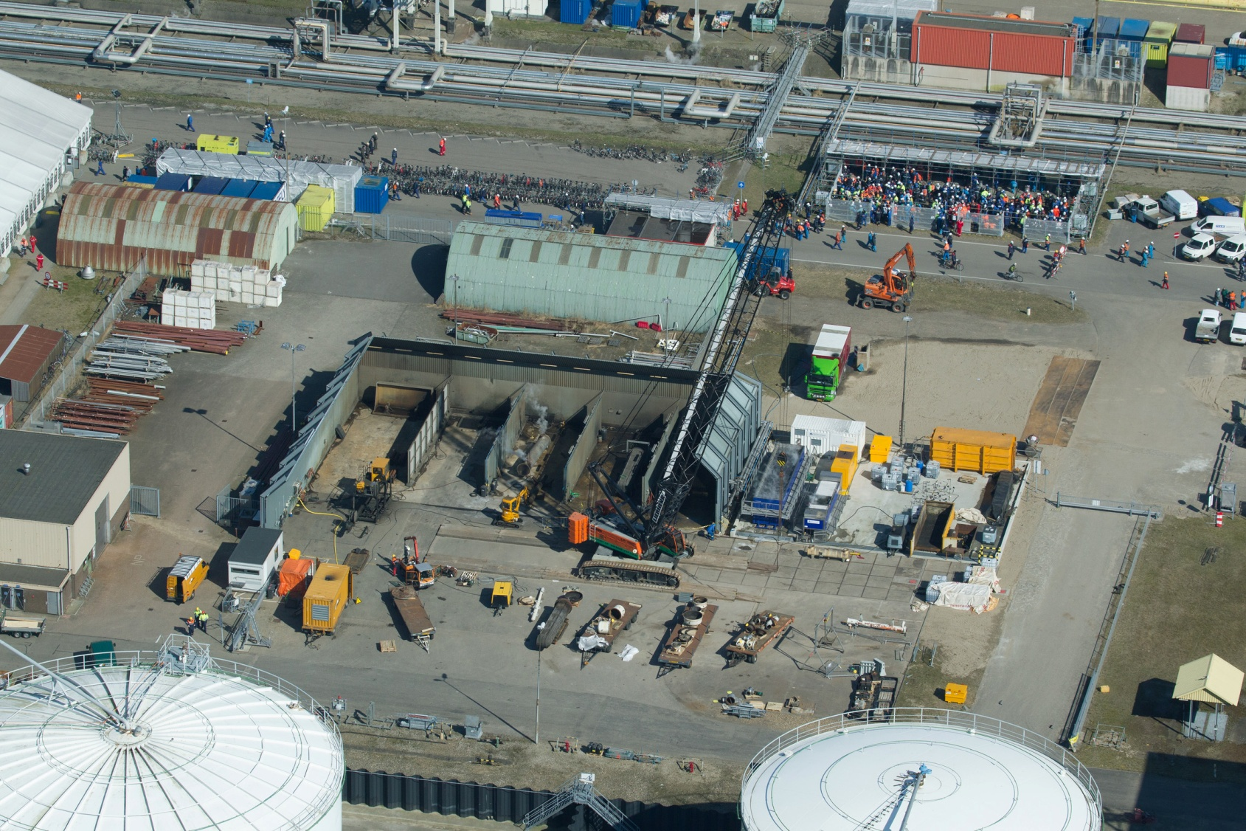
Layout of the Wash pad
350 pk
US containers
500 bar ww unit
350 pk

Slide 4
Water footprint comparison MLO TA 2013
US Cleaned: 51 bundles, 700 accessories, working 2 * 10 hrs/day for 16 days
Ultrasonic & Hydroblasting
2* 350 pk (bhp) pump, 1000 bar (14500 psi) at 130 ltr/min = 15,6 m3/hr
1* 500 bar (7250 psi) warm water unit at 25 ltr/min = 1,5 m3/hr
Actual average usage: 60 m3/day
Only Hydroblasting
2* 600 pk (bhp) pump, 1000 bar (14500 psi) at 225 ltr/min = 27 m3/hr
2* 350 pk (bhp) pump, 1000 bar (14500 psi) at 130 ltr/min = 15,6 m3/hr 44,1 m3/hr
1* 500 bar (7250 psi) warm water unit at 25 ltr/min = 1,5 m3/hr
Working 50% of the hours = 10 hrs/day gives 441 m3/day
Result: reduction of 86%; saving a total of 6100 m3 of fresh water during TA

Slide 5
Costs / savings
Costs saving fresh water 6.100 m3 x € 1,30 = € 7.930,-
Costs saving waste water 6.100 m3 x € 100,- = € 610.000,-
Costs saving diesel oil 1.200 HP x 0,2 x 15 hrs x 16 days = € 57.600,-
Energy Ultrasonic for 9 m and 6 m 300 HP x 0,2 x 15 hrs x 16 days = € 14.400,-
Total savings diesel oil € 57.600,- – € 14.400,- = € 43.200,-
Chemical costs € 100,- x 15 x 16 = € 24.000,-
Cleaning costs chemicals
after shutdown € 10.000,-

Slide 6
INVESTMENT
Investment high pressure
2 x 600 HP with truck bundle blaster = approx. € 800.000,-
2 x Bundle cleaner with robot tube cleaner = approx. € 800.000,-
Total investment = € 1.600.000,-
Investment ultrasonic system
9 m vessel € 1.400.000,-
6 m vessel € 650.000,-
Total investment = € 2.050.000,-
Difference in investment = approx. 22 % less for high pressure

Slide 7
Operating costs
Man power
High pressure pump operators for two pumps = 4 operators
Ultrasonic operators for two vessels = 2 operators
Labour savings
2 operators x 20 working hours x € 30,- a/h x 16 days = € 19.200,-

Slide 8
Resources
The CEO Water Mandate, jan. 2011
http://ceowatermandate.org/files/Ceo_water_mandate.pdf
VEMW Duurzaam industrieel watergebruik
www.vemw.nl
Reports and photo’s of the cleaned equipment
https://sww-knowledge.shell.com/knowhow/livelink.exe?func=ll&objId=160530977&objAction=browse&sort=name

